Slide 1

New Biomass Stoves and Carbon Credits
Dean Still
Executive Director, Aprovecho Research Center

Slide 2
Overview of today’s talk
Background history on stoves development
Understanding modern stoves
New market approaches :top down versus bottom up
International standards
Carbon credits

Slide 3
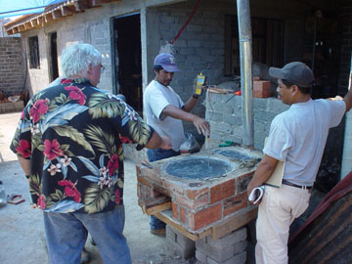
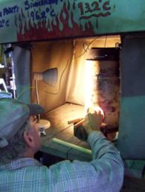
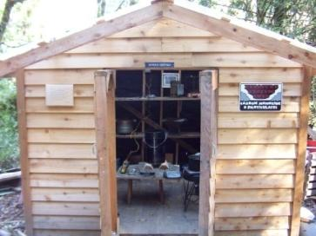
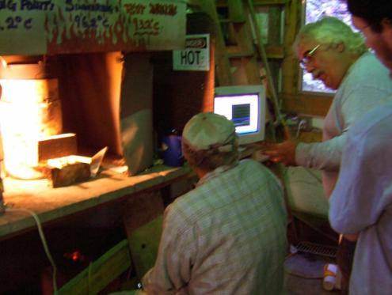
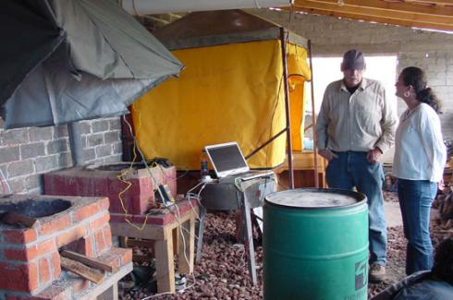
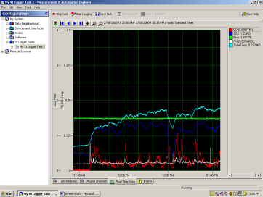
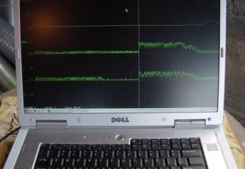
Aprovecho: Testing Stoves
Laboratory Testing
In-Field Testing

Slide 4
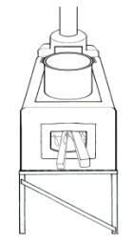
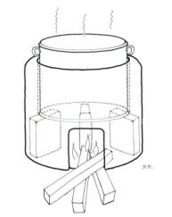
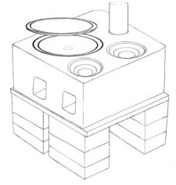
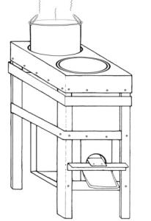
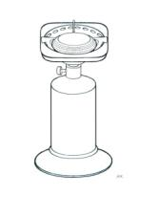
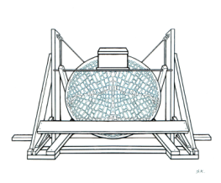
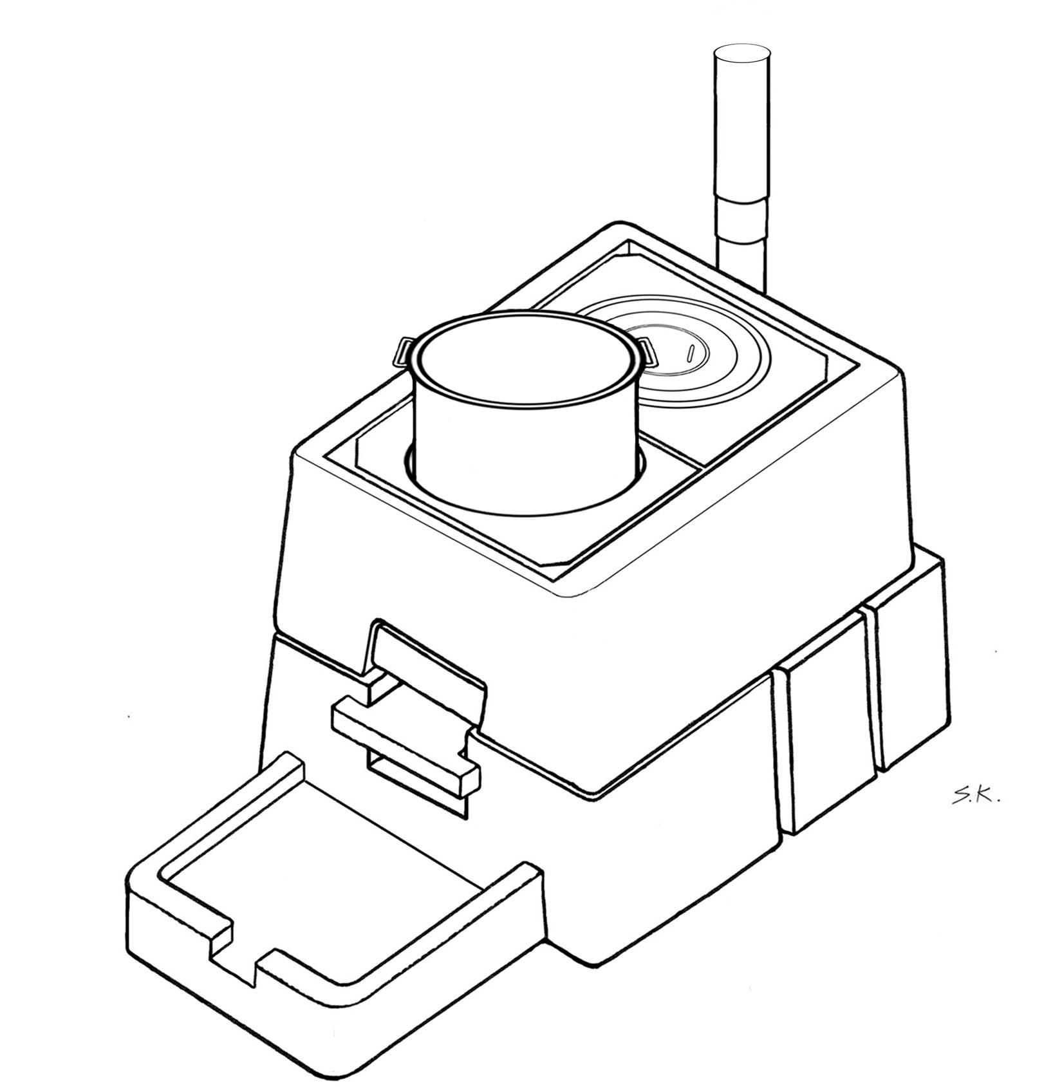
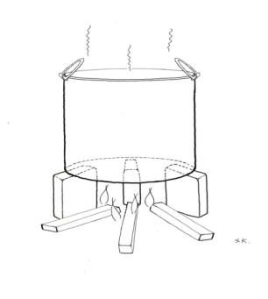
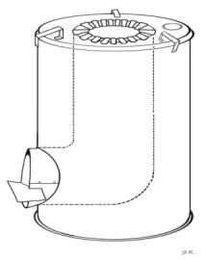
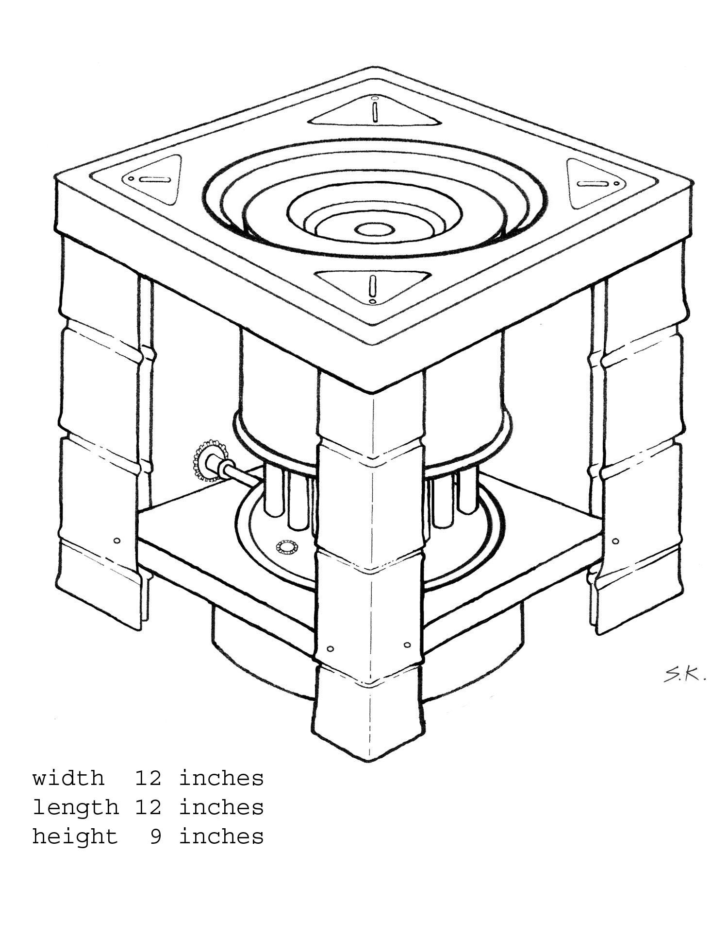
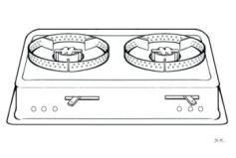
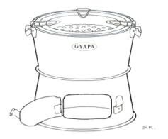
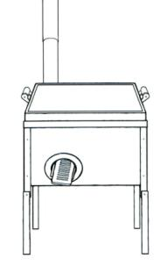
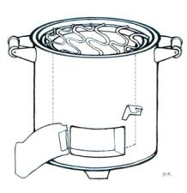
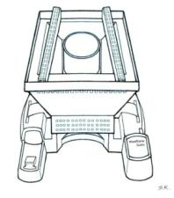
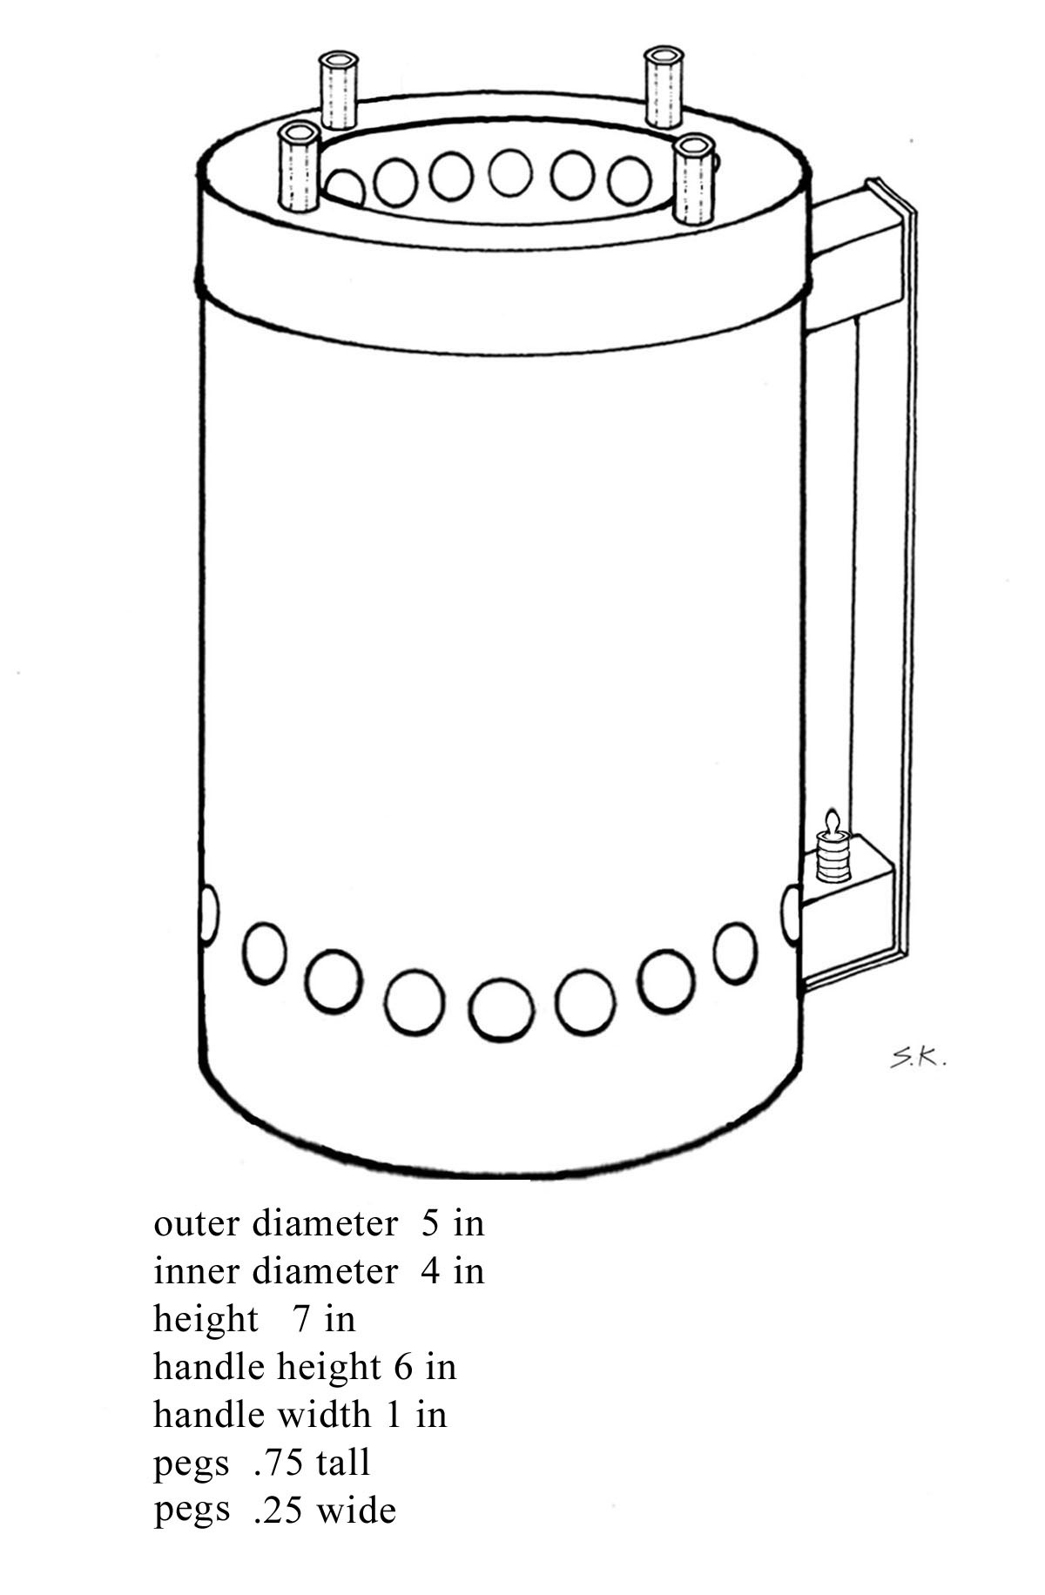
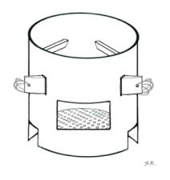
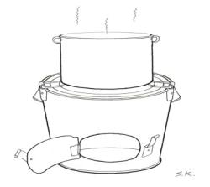
Cooking Stoves
Aprovecho has a library of tests from over 50 stoves in use around the world.

Slide 5
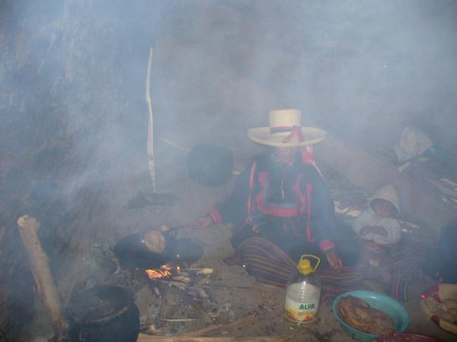
Health impact of solid fuels
Indoor Air Pollution
  1.6 million premature deaths per year according to WHO
  Asthma, Colds, Eye Irritation, COPD, Pneumonia, ALPD, …

Slide 6
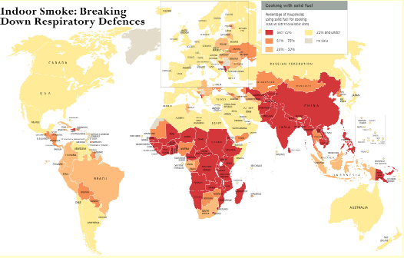
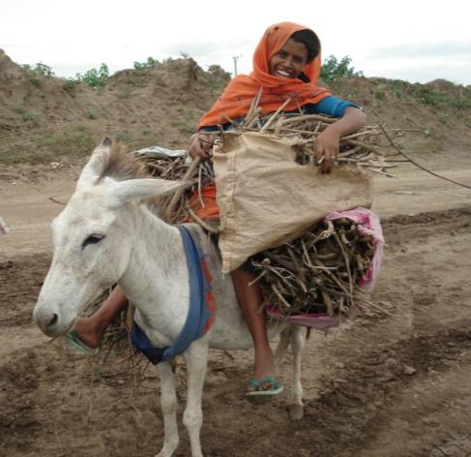
Worldwide use of solid fuels
Global Warming :CO2, CH4, CO and black carbon emissions
  from inefficient biomass stoves is accelerating warming
  (Brown cloud over Asia)
Excessive Fuel Use: Deforestation,
  Desertification and Drudgery/Danger

Slide 7
CookStoves: A Troubled History
Bad “Improved” Stoves have been made
A broad misunderstanding of traditional methods and cultures, as well as heat transfer and combustion, led to the faulty assumption that any stove is better than none
Many designers still do not understand insulation vs. mass
Manufacturing high-quality stoves in-country on a small scale has been a challenge
Testing was not widely done to optimize and/or validate performance
Stable financing was not generally available

Slide 8

Modern Stoves: A Four-Legged Approach
Research & Development
Manufacturing
Marketing
Finance
How close are we?

Slide 9
Defining “Improved” CookStoves
Research & Development
Good Stoves Can Turn Wood Into Clean Energy
Stoves need to be as carefully designed as Toyotas.
Moving forward:
  Testing Needs to be standardized
    In 2003, Shell Foundation/UCBerkeley/Aprovecho revised 3 test protocols to quantify and compare performance in lab, field, and homes.
    Gold Standard has been developed for fuel savings/carbon credits.
  R&D is required to quantify and improve combustion and heat transfer efficiency
    Aprovecho provided first extensive laboratory fuel use and emissions testing, many other large organizations have also begun testing
    Emissions testing kits are now available from Aprovecho
    Without comparisons we don’t know what we are aiming to achieve
  International Standards are needed to provide minimum requirements of stove performance.

Slide 10
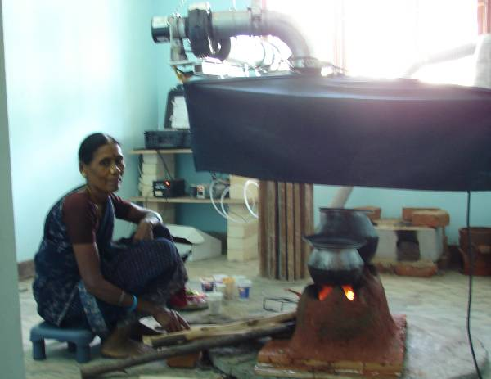
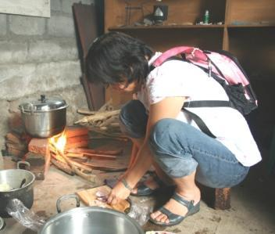
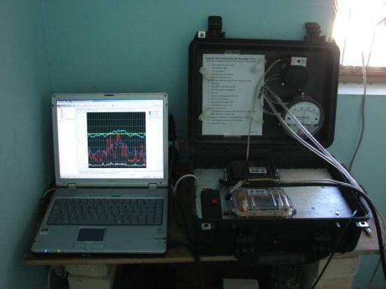
Testing CookStoves
Research & Development
Aprovecho has designed easy-to-use emissions equipment, available to help projects with stove testing:
Portable Emissions Measurement System (PEMS)
Indoor Air Pollution/Exposure Meter

Slide 11
Benchmarks for Stove Performance
Research & Development
The Aprovecho Library of performance of over 50 stoves was used to create benchmarks for Shell Foundation, Philips, and others.
International Standards are in the works…

Slide 12
Benchmarks for Stove Performance
Research & Development
Fuel Use Benchmark: The wood-burning stove without chimney should use less than 850 g of wood (15 MJ of energy) to complete the WBT.

Slide 13
Benchmarks for Stove Performance
Research & Development
CO Benchmark: The wood-burning stove without chimney should emit less than 20 g of carbon monoxide to complete the WBT.

Slide 14
Benchmarks for Stove Performance
Research & Development
PM Benchmark: The wood-burning stove without chimney should emit less than 1500 mg of PM to complete the WBT.

Slide 15
Performance Standards
Research & Development
Ideally, standards will:
  Encourage development locally to compete with companies selling stoves globally
  Improve all stoves by keeping big and small stove makers on the same page
  Help to promote user safety considerations in stove designs
  Increase stove durability and longer performance
  At the end, ensure stove projects are worth pursuing

Slide 16
Improvements in Design
Research & Development
Heat Transfer can be improved
  Containing the fire and forcing heat against the pot can save 30-50% of fuel compared to Open Fire
Combustion Efficiency can be improved
  Several methods of combustion can save 50-90% of emissions compared to Open Fire
    Rocket Combustion Chamber from China ($2= ½ emissions)
    Gasification ($5 = ½ emissions)
    Fan Stove ($20= 1/8 emissions)

Slide 17
Moving Biomass a Step Up the “Energy Ladder”
Research & Development
Stoves with small (1 Watt) electric fan can burn wood as cleanly as kerosene
  40% Of Biomass Users Have Electricity in Their Homes
Chimneys: The solution to Indoor Air Pollution?
  Chimneys remove smoke in the US, Europe: Why not everywhere?

Slide 18
The energy ladder
Marketing
Electricity
LPG
Alcohol
Kerosene
Charcoal/coal
Wood
Dung
Biomass waste or plastic
Three groups of people using traditional solid fuels:
The poorest of the poor (< US$ 1.25day)
(will not move up the energy latter, need subsidy?)
The poor (US$ 1.25-3 day)
(long term transition) *Immediate commercial market
The low middle class (> US$ 3/day)
(Likely in transition ?)
Social-Economical development

Slide 19
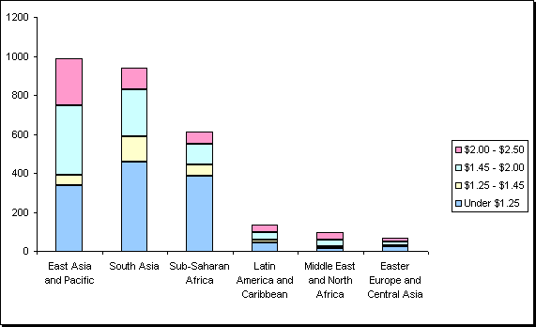
Market size
Marketing
Poverty lines (millions of people) by mean per capita consumption (US$ per day)
Regional breakdown of the 2005 poverty lines (millions)
Source: Chen and Ravallion (2008)

Slide 20
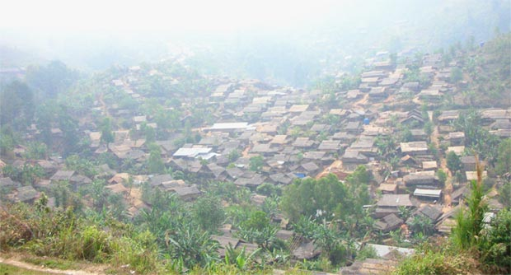
Complimentary Approaches
Manufacturing
SMALL LOCAL PRODUCERS
LARGE INDUSTRIAL PRODUCERS
3 billion people = Huge Market
There is room for everyone.

Slide 21
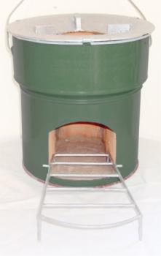
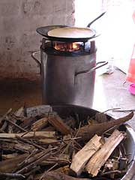
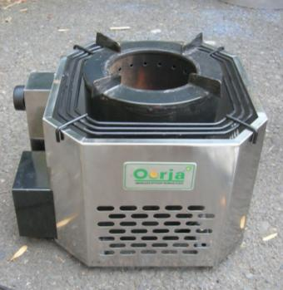
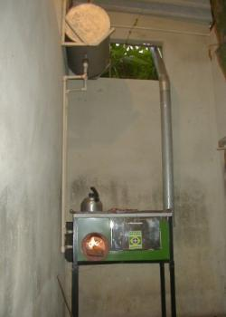
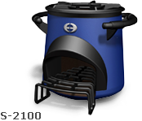
Manufactured Stoves for Sale Today
Manufacturing
StoveTec
Philips
Envirofit – Shell
British Petroleum
Ecostoves

Slide 22
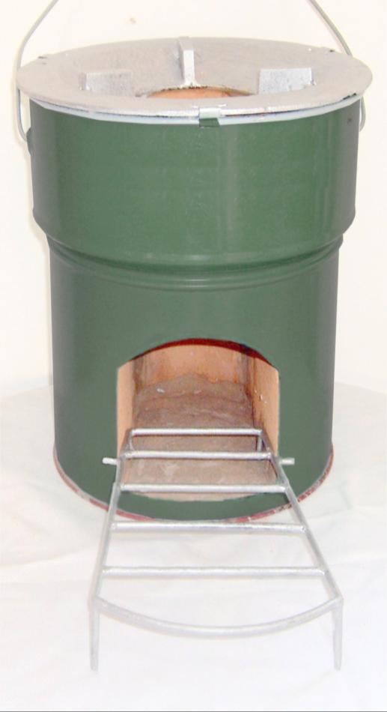
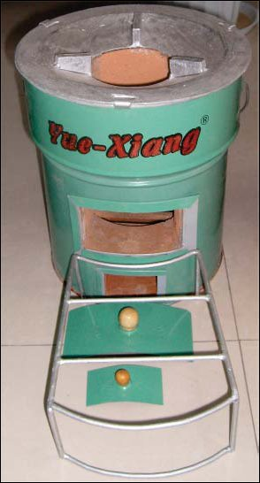
StoveTec: powered by “rocket stove”, made in China for the global market. Optional fan wood and charcoal burning stove.

Slide 23
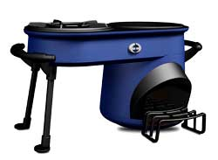
Envirofit-Shell: powered by rocket stove, sold in India (& Brazil and Eastern Africa).

Slide 24
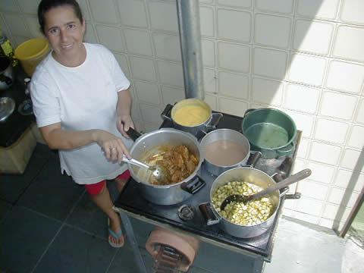
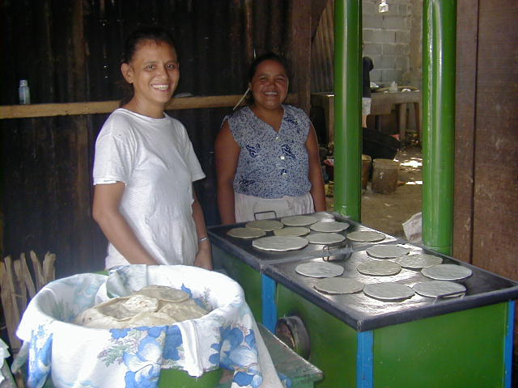
Ecostove: powered by rocket stove, made and sold in Latin America by SMEs (Brazil, Honduras, Nicaragua and Bolivia). One model for many markets.

Slide 25
Philips: made and sold in India. Thermoelectric powered fan.

Slide 26
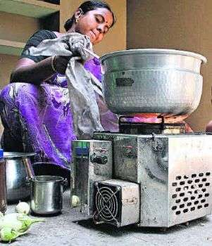
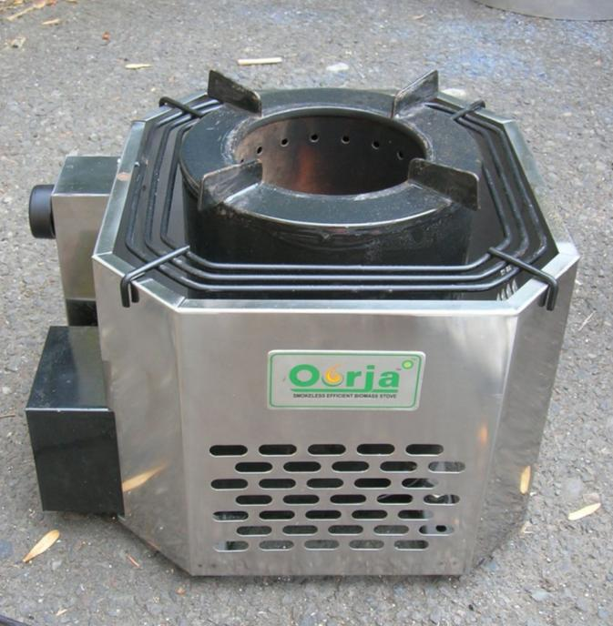
British Petroleum (BP): fan stove, made and sold in India. Pellet fueled.

Slide 27
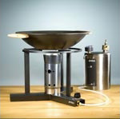
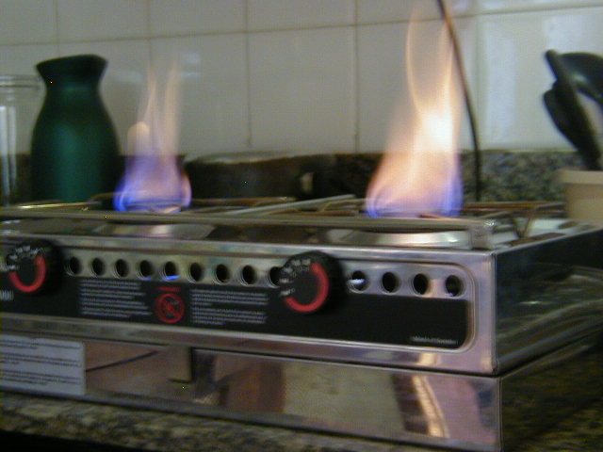
Biofuels stoves
Dometic: ethanol stove for Africa and Brazil.
Bosch-Siemens: plant oil stove for Asia market

Slide 28
Manufacturing of Improved Cook Stoves: Adding Opportunity
Manufacturing
Local Production
  + PROS: Better knowledge of market, Lower transportation costs, Capacity building
  - CONS: Unimproved design, Lower quality materials, Lower Quality Control and consistency, Home-made appearance, May not meet Benchmarks
Centralized Production
  + PROS: Improved design, Higher quality materials, Higher quality control, Meets Benchmarks, Modern factory-made appearance
  - CONS: Generic stove may not be a great fit, Higher transportation costs, Adds distribution jobs but not manufacturing

Slide 29
Financing Stove Programs
Financing
Foundations
Government
Aid Agencies
Microfinance
Carbon Markets – The new opportunity

Slide 30
The Newest Source of Funding: Carbon Credits
Financing

Slide 31
Carbon Emissions
Financing
Emission | Global Warming Potential (GWP) – 100 year time-frame -- | Potential Reduction from Three-Stone Fire Methods
Primary Kyoto Basket
Carbon Dioxide CO₂ | 1 | ~ 30-50%
Methane CH₄ | 25 IPCC 2007 | ~ 75%
Nitrous Oxide N₂O | 298 IPCC 2007 | N/A
Secondary Kyoto Basket
Carbon Monoxide CO | 1.9 IPCC 2007 | ~ 75%
Others Not Yet Counted
Unburned Hydrocarbons NMHC | 12 Smith, 2002 | ~ 75%
Black Carbon EC | 680 Bond, 2005 | 0-90%

Slide 32
Carbon and Cookstoves
Financing
Household stoves can save about 1-3 tons of CO₂ per year based on fuel reductions alone
Cleaner-burning stoves get extra credit as well
~$30 per Ton CO_{2eq.} per year currently – projected to increase after U.S. elections
Credit can cover costs of both the Stove and the Distribution?
Improved Rocket, Fan and Gasifier Stoves can provide substantial carbon savings.
Source: MacCarty et al., A Laboratory Comparison of the Global Warming Impact of Five Major Types of Biomass Cooking Stoves, Energy for Sustainable Development, June 2008.

Slide 33
Gold Standard Certification
Financing
Based on verified kitchen survey proving savings
Statistically Significant Results (~100 Houses)
Fuel use measured, Emissions predicted
Also considers stove lifetime

Slide 34
Many Marketing Chains…
Marketing
Retail
Relief
Microfinance
Social entrepreneurship
NGOs
National Distribution Chains
Local Markets
Governments

Slide 35
Many Networking Opportunities…
Marketing

Slide 36
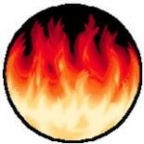
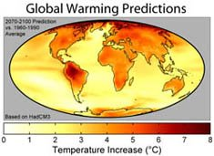
Biomass Stoves Today
Research & Development
Manufacturing
Marketing
Finance
R& D
Manufacturing
Finance
Marketing (BC)
Availability

